Slide 1

The CAIDA “DDoS Attack 2007” Dataset
Team:
Tiffany Lee
Brenda Mejia
Mackenzie Falla

Slide 2
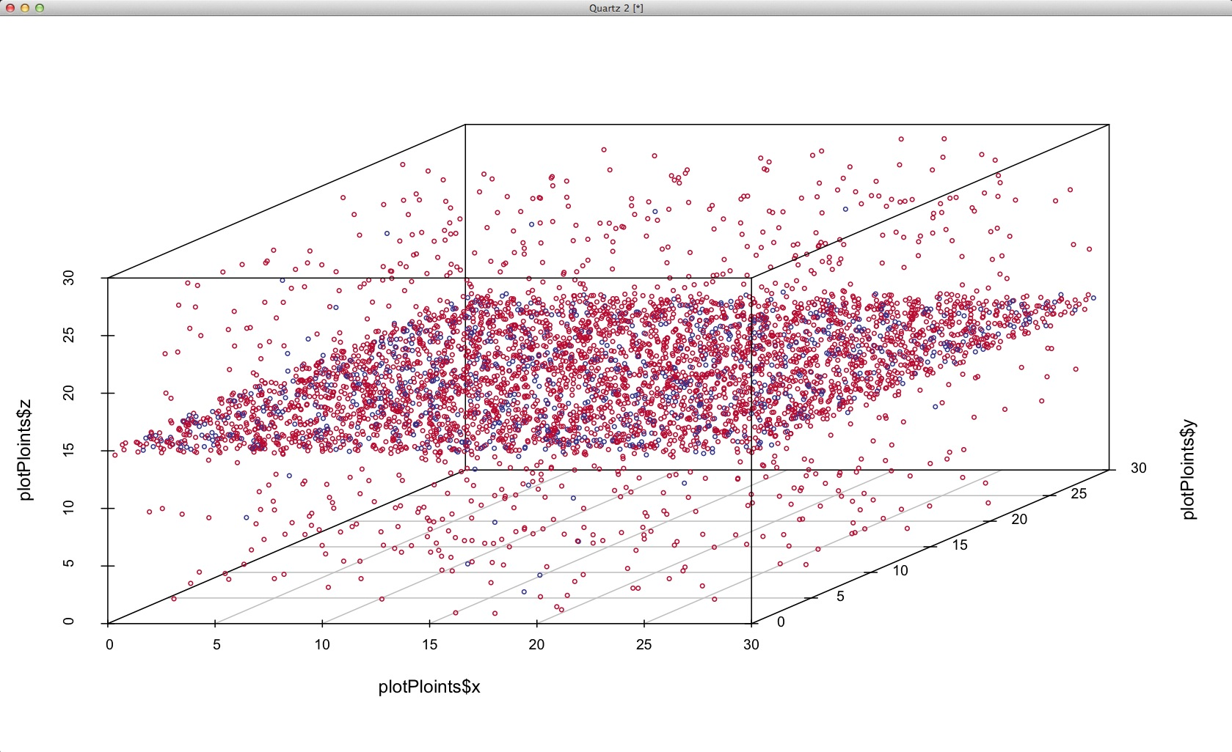
About the Dataset:
The CAIDA "DDoS Attack 2007" Dataset
https://www.caida.org/catalog/datasets/ddos-20070804_dataset/
Tiffany Lee
Collected by the Center for Applied Internet Data Analysis (CAIDA).
Contains approximately one hour of anonymized traffic traces from a DDoS attack on August 4, 2007.
The dataset is available in pcap format. The total size of the dataset is 5.3 GB (compressed) and 21 GB (uncompressed).
This attack primarily targeted high-profile, high-bandwidth networks rather than individual consumer devices.
The attack targeted core internet protocols, such as ICMP (ping flooding) and UDP, typical of large-scale DDoS attacks aimed at overwhelming network resources and server capacities.

Slide 3
Playbook: Distributed Denial-of-Service Playbook by Cyber Security Agency of Singapore
Tiffany Lee
playbook-for-ddos.pdf
The purpose of the DDoS Playbook is to provide organizations with a structured guide for identifying, containing, and mitigating Distributed Denial-of-Service (DDoS) attacks.
Encourages routine training and awareness among employees on detecting and responding to DDoS threats, fostering a culture of cybersecurity readiness.
Ensures key stakeholders, including clients, employees, and regulatory bodies, are informed and updated in the event of an attack.
Outlines methods to collect evidence, allowing organizations to understand the attack’s nature, determine vulnerabilities, and enhance future resilience.

Slide 4




Tools Used:
Mackenzie Falla
Using Splunk to analyze network traffic data and generate summarized insights
This Photo by Unknown Author is licensed under CC BY-SA
Utilizing Wireshark for packet analysis and preliminary investigation.
This Photo by Unknown Author is licensed under CC BY-NC-ND
This Photo by Unknown Author is licensed under CC BY-SA-NC
Using Excel to consolidate and summarize triage information we converted PCAP file.
Catalyst was used to generate a report with the gathered information.
This Photo by Unknown Author is licensed under CC BY-NC-ND

Slide 5
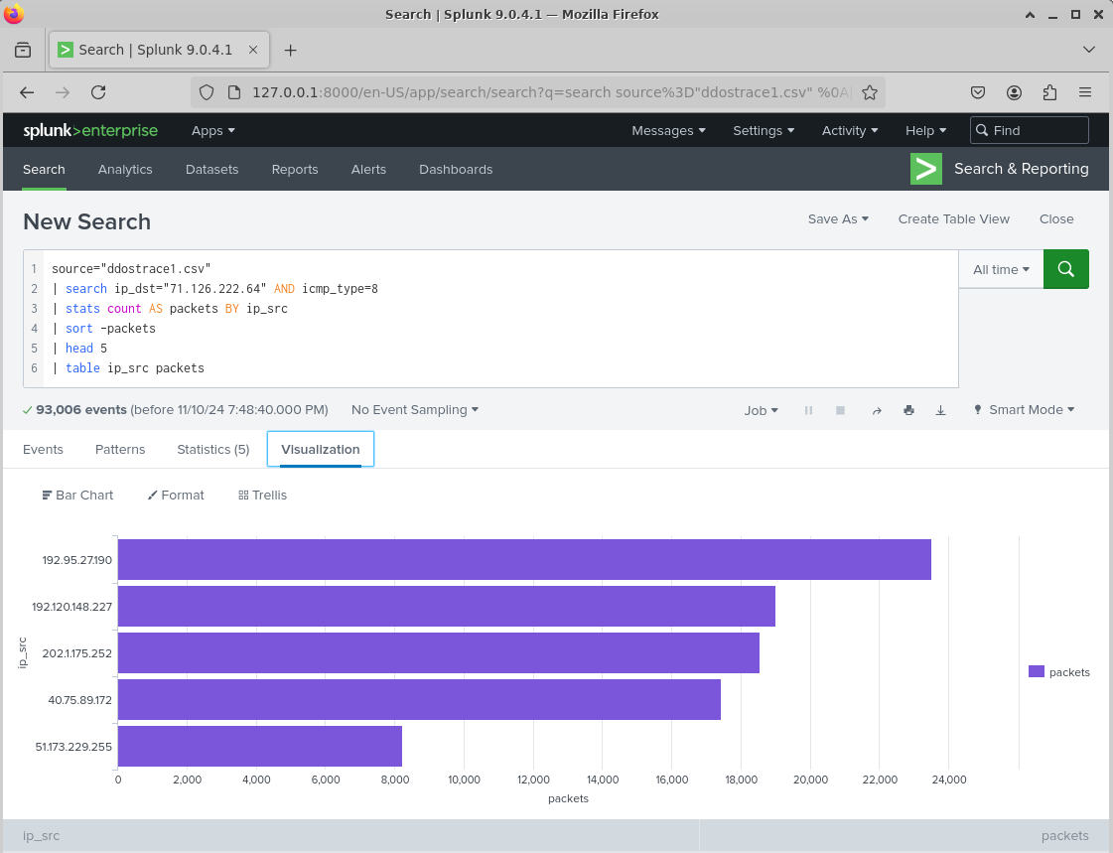
File in Splunk
Key Findings:
Brenda Mejia
Hypothesis: What are 3 things you expect to find when you analyze the data?
Finding #1: | A surge of high-volume traffic from multiple sources targeting the destination within a short timeframe.
Finding #2: | Anomalous traffic patterns, marked by a sudden surge in volume.
Finding #3: | Variation in attack techniques indicates the use of multiple attack types.

Slide 6
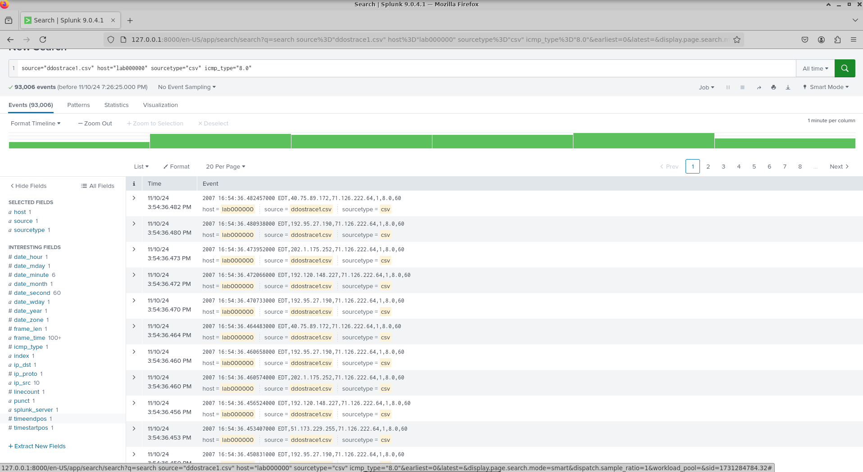

Slide 7
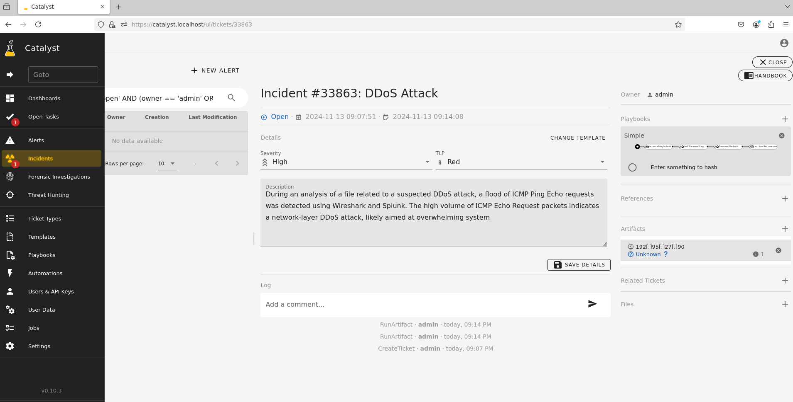
Catalyst Results

Slide 8
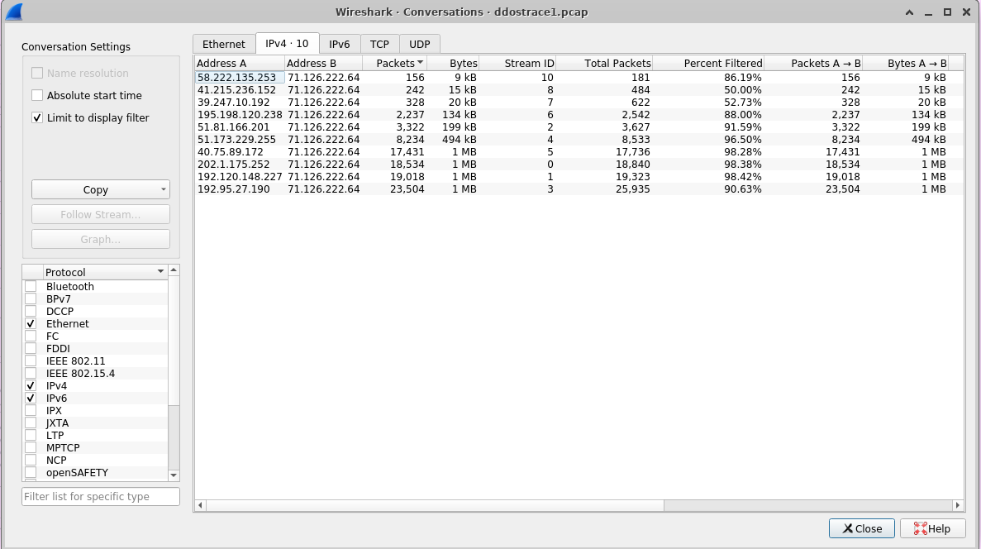
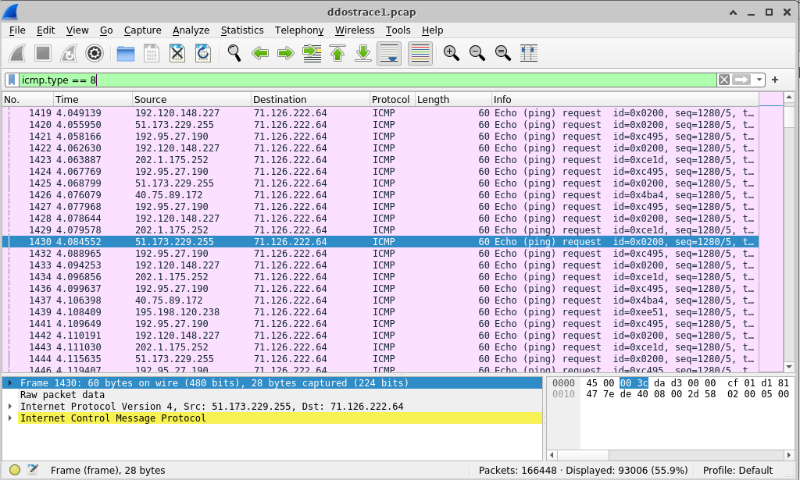
The database (PCAP File) in Wireshark

Slide 9
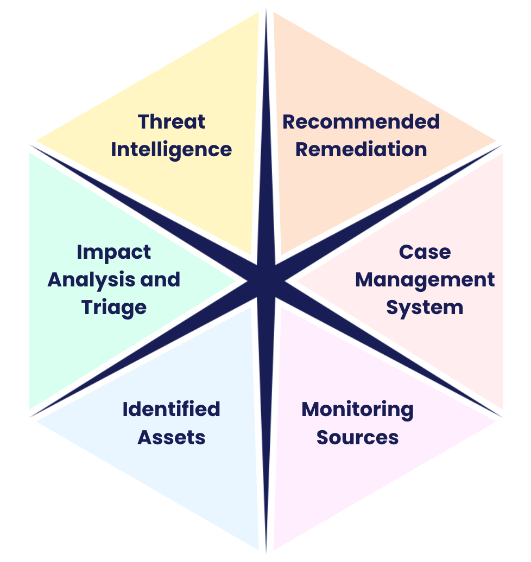
Some Key Aspects:
Mackenzie Falla
Threat Intelligence = Information about attackers’ protocols(TTP’s), techniques, tactics observed within the dataset. Our project uses threat intelligence to identify the specific methods attackers use to characterize the DDoS strategy deployed.
Monitoring Sources = is essential to detect unusual activity in network traffic that could signify a DDoS attack. Using Wireshark we analyzed the PCAP files to observe traffic spikes and patterns.
Identified Assets = We focus on our server targeted by DDoS attack and the pathways of high-bandwidth traffic impacting it. Tracing packet flow on wireshark we can observe how the attack impacted this server specifically so we can adjust traffic from other sources or assets.

Slide 10
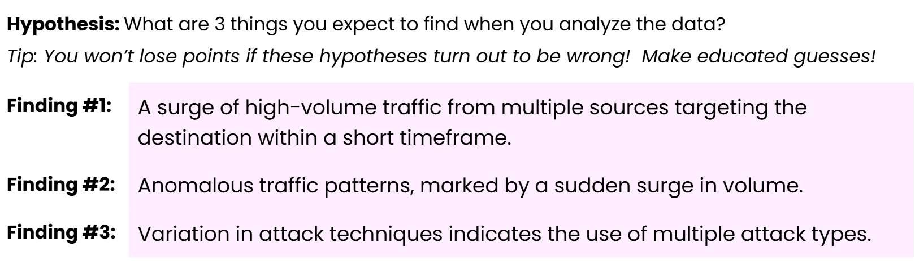
Results:
Brenda Mejia
Unusual amount of pings
Multiple external servers were used to send the pings
What was interesting about our search?
What did we expect to happen?
What actually happened?
Speed of attack

Slide 11
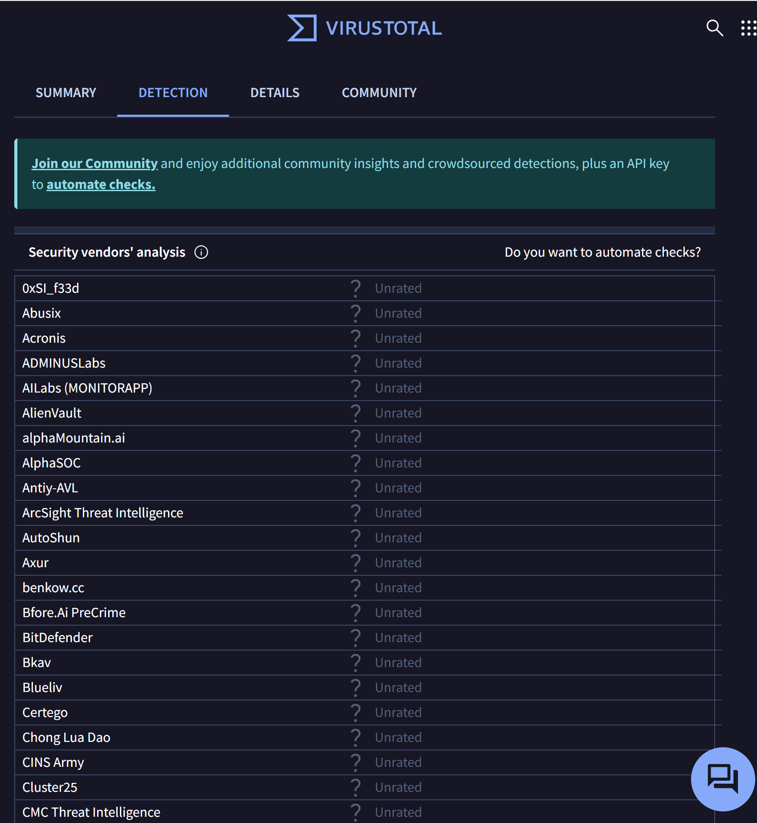
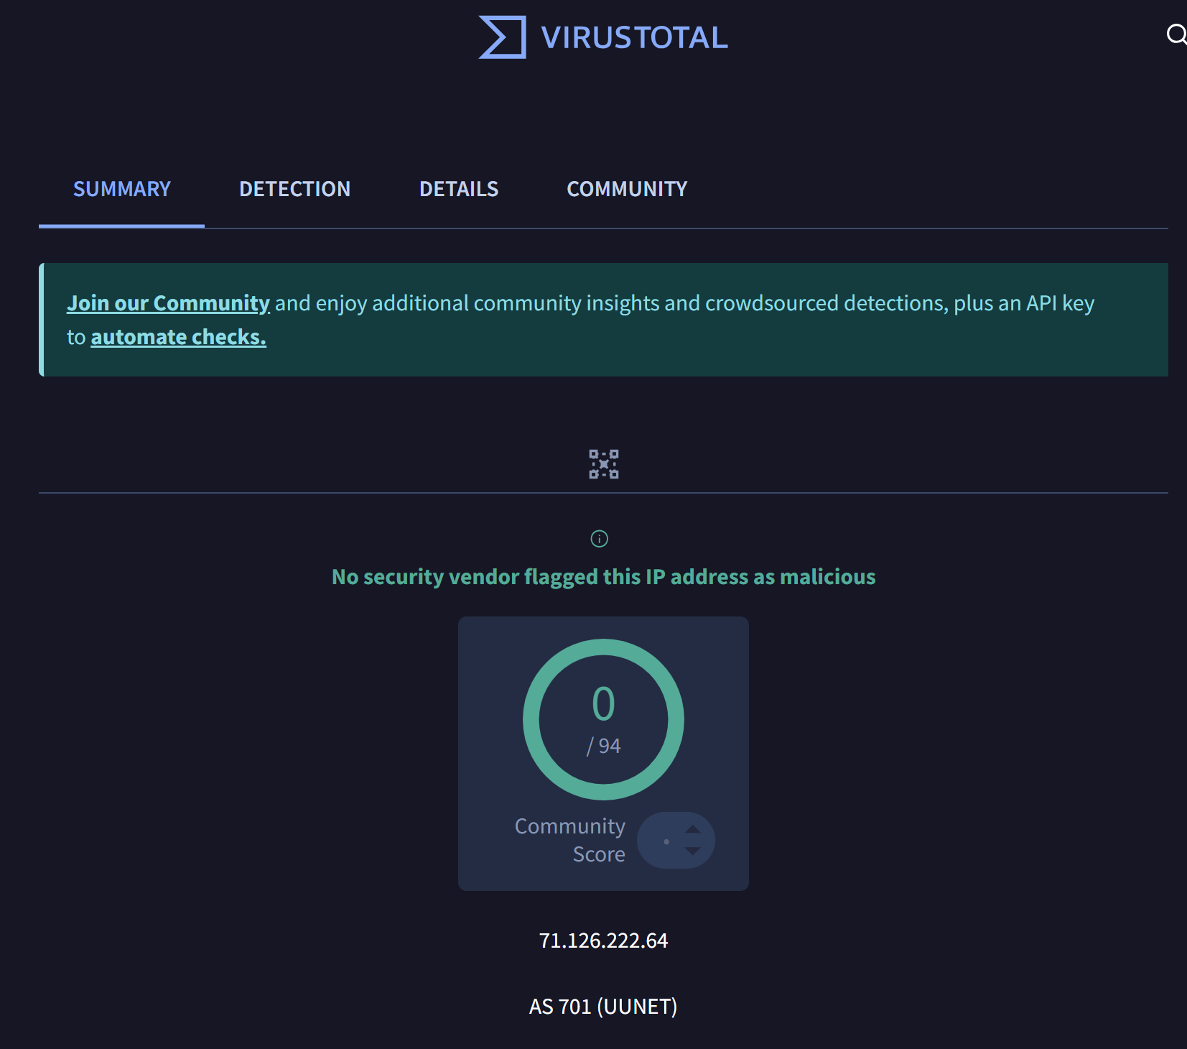
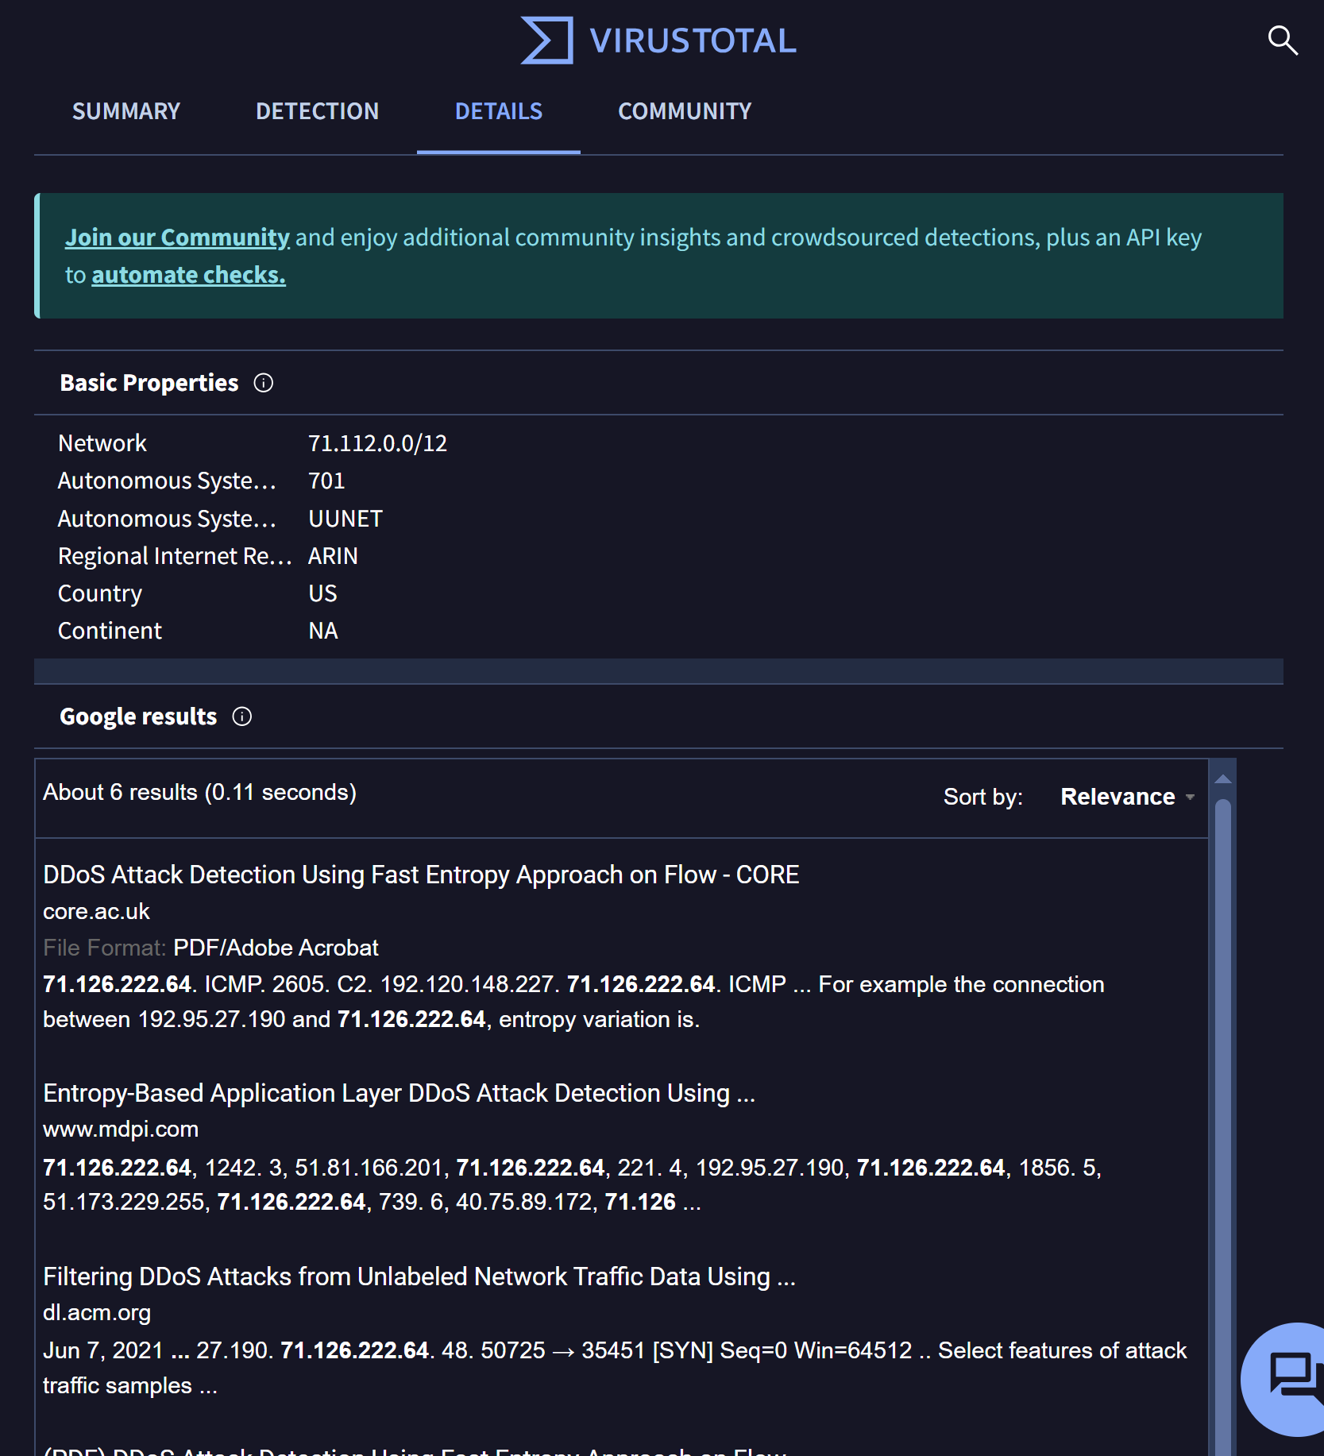
Virus Total:
Mackenzie Falla

Slide 12
Basic Properties
Network
71.112.0.0/12
Autonomous System Number
701
Autonomous System Label
UUNET
Regional Internet Registry
ARIN
Country
US
Continent
NA
Google results
DDoS Attack Detection Using Fast Entropy Approach on Flow - CORE
core.ac.uk
File Format: PDF/Adobe Acrobat
71.126.222.64. ICMP. 2605. C2. 192.120.148.227. 71.126.222.64. ICMP ... For example the connection between 192.95.27.190 and 71.126.222.64, entropy variation is.
Entropy-Based Application Layer DDoS Attack Detection Using ...
www.mdpi.com
71.126.222.64, 1242. 3, 51.81.166.201, 71.126.222.64, 221. 4, 192.95.27.190, 71.126.222.64, 1856. 5, 51.173.229.255, 71.126.222.64, 739. 6, 40.75.89.172, 71.126 ...
Filtering DDoS Attacks from Unlabeled Network Traffic Data Using ...
dl.acm.org
Jun 7, 2021 ... 27.190. 71.126.222.64. 48. 50725 → 35451 [SYN] Seq=0 Win=64512 .. Select features of attack traffic samples ...
(PDF) DDoS Attack Detection Using Fast Entropy Approach on Flow
www.researchgate.net
Oct 22, 2024 ... ... 71.126.222.64. ICMP. 2605. C2. 192.120.148.227. 71.126.222.64. ICMP. 1831. C3. 202.1.175.252. 71.126.222.64. ICMP. 1786. C4. 40.75.89.172.
Feature Selection to Enhance DDoS Detection Using Hybrid N ...
joiv.org
File Format: PDF/Adobe Acrobat
The relationship between 192.95.27.190 and 71.126.222.64,. e.g., The resultant value of 7.46 compared to the other relationships, is significant. However ...
Feature selection to improve distributed denial of service detection ...
telkomnika.uad.ac.id
File Format: PDF/Adobe Acrobat
27.190 and 71.126.222.64. The resulting value is substantial, namely 7.46 compared to other connections. However, this proposed method performs forward ...

Slide 13

Remediation
A strong firewall and proper traffic monitoring would result in a decrease of the chances of an attack.
Networking has greatly improved since 2007. With the introduction of firewalls, traffic between IP pairs or specific protocols can be blocked.
Recommendation is to block ICMP ping traffic aimed toward the victim IP of 71.126.222.64. This would remove the load on the victim’s Networking stack to reply to these Pings
Multiple ICMP pings received the same message that returned the host / port is unavailable

Slide 14
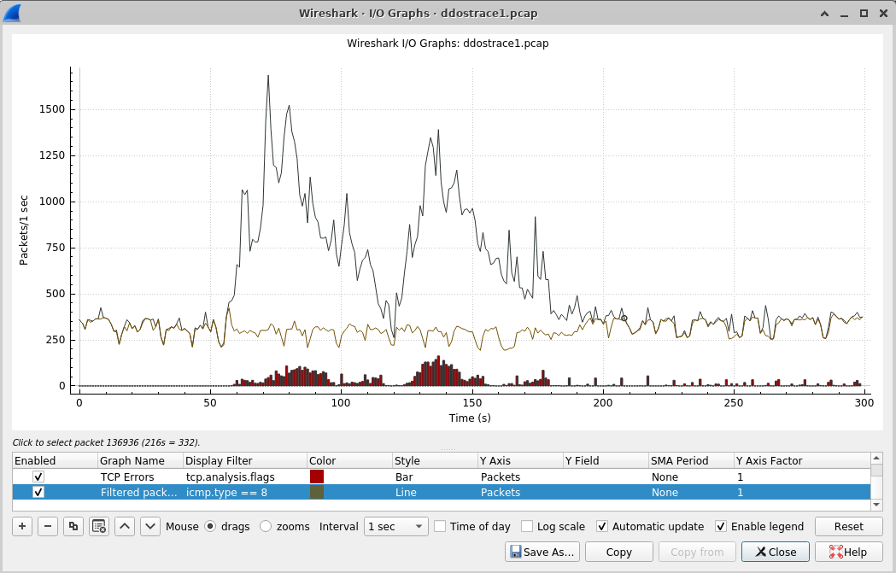
Conclusion
Tiffany Lee
References:
playbook-for-ddos.pdf
https://www.caida.org/catalog/datasets/ddos-20070804_dataset/
Any Questions?

